Slide 1


CSE 470 – Class Diagram Design
BRAC University

Slide 2
Guidelines for Analyzing Requirements / Use Cases
A common or improper noun implies a class of objects
A proper noun implies an instance of a class
A collective noun implies a class of objects made up of groups of instances of another class
Notes:
Class diagram
Examine the text to identify potential objects, attributes, operations, and relationships

Slide 3
Guidelines for Analyzing Requirements / Use Cases (2)
An adjective implies an attribute of an object
A doing verb implies an operation
A being verb implies a relationship between an object and its class
A having verb implies an aggregation or association relationship
Notes:
Class diagram
Examine the text to identify potential objects, attributes, operations, and relationships

Slide 4
Guidelines for Analyzing Requirements / Use Cases (3)
A transitive verb implies an operation
An intransitive verb implies an exception
A predicate or descriptive verb phrase implies an operation
An adverb implies an attribute of a relationship or an operation
Notes:
Transitive Verb
The meaning of a transitive verb is incomplete without a direct object, as in the following examples:
INCOMPLETE COMPLETE
The shelf holds. The shelf holds three
books and a vase of
flowers.
The committee named. The committee named a
new chairperson.
The child broke. The child broke the plate.
Intransitive Verb
An intransitive verb, on the other hand, cannot take a direct object.
Example: This plant has thrived on the south windowsill.
Predicate
part of the sentence that contains a verb or verb phrase and its complements

Slide 5
Class Diagram
Ensure that the classes are both necessary and sufficient to solve the underlying problem
no missing attributes or methods in each class
no extra or unused attributes or methods in each class
no missing or extra classes
Notes:
Constraints
Example of constraint: attribute that can only be within a certain range
Look at the pre-conditions and post-conditions in the use cases
Decide how to handle violations to the constraints (how to handle errors/exceptions)

Slide 6
Discarding Unnecessary and Incorrect Classes
Redundant Classes: Some potential classes differ only in name.
Irrelevant Classes: Classes that have nothing to do with the system. Example: computer connection
Vague Classes: Classes whose meaning is not clear at all. Examples: system and software
Notes:
Redundant Classes: Some potential classes differ only in name.
Irrelevant Classes: Classes that have nothing to do with the system. Example: computer connection
Vague Classes: Classes whose meaning is not clear at all. Examples: system and software.
Attributes: Some nouns in the list above are likely to be modeled as attributes rather as classes. Examples: author, title
Operations: Some nouns are likely to be operations rather than classes. Example: book search.
Roles: Some nouns are roles of objects involved in associations rather than classes.
Implementation Constructs: Anything that is not part of the real-world problem.

Slide 7
Discarding Unnecessary and Incorrect Classes
Attributes: Some nouns in the list above are likely to be modeled as attributes rather as classes. Examples: author, title
Operations: Some nouns are likely to be operations rather than classes. Example: book search.
Roles: Some nouns are roles of objects involved in associations rather than classes.
Implementation Constructs: Anything that is not part of the real-world problem.
Notes:
Redundant Classes: Some potential classes differ only in name.
Irrelevant Classes: Classes that have nothing to do with the system. Example: computer connection
Vague Classes: Classes whose meaning is not clear at all. Examples: system and software.
Attributes: Some nouns in the list above are likely to be modeled as attributes rather as classes. Examples: author, title
Operations: Some nouns are likely to be operations rather than classes. Example: book search.
Roles: Some nouns are roles of objects involved in associations rather than classes.
Implementation Constructs: Anything that is not part of the real-world problem.

Slide 8
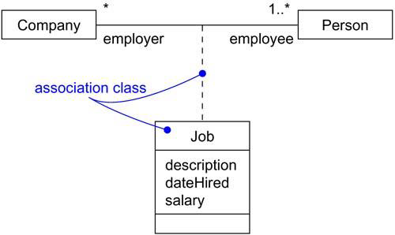
Association Class
In an association between two classes, the association itself might have properties.
For example, in an employer/employee relationship between a Company and a Person, there is a Job that represents the properties of that relationship that apply to exactly one pairing of the Person and Company.
It wouldn't be appropriate to model this situation with a Company to Job association together with a Job to Person association. That wouldn't tie a specific instance of the Job to the specific pairing of Company and Person.

Slide 9
Types of Classes
Ones found during analysis:
people, places, events, and things about which the system will capture information
ones found in application domain
Ones found during design
specific objects like windows and forms that are used to build the system
Notes:
Class diagram
Name typed in top compartment

Slide 10
Example of a Class Diagram
Video Rental System
visibility
multiplicity
class name
Customer
Video
1..*
1..*
-CID: int
-name: String
-cassetteID : int
-cassetteVolumeNo: int
rents
+authenticateCustomer ()
+rentMovie()
attributes
methods
relationship
Notes:
-cassetteID: int
-cassetteVolumeNo: int

Slide 11
Class diagram example 1
Multiplicity
Customer
1
Simple
Aggregation
Class
Abstract
Class
Rental Invoice
Rental Item
1..*
1
0..1
Composition
Simple
Association
Generalization
Checkout Screen
DVD Movie
VHS Movie
Video Game

Slide 12
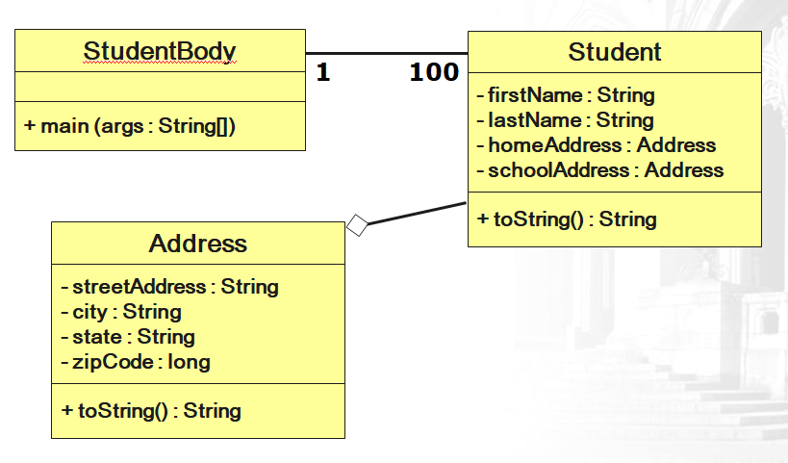
Class diagram example 2

Slide 13
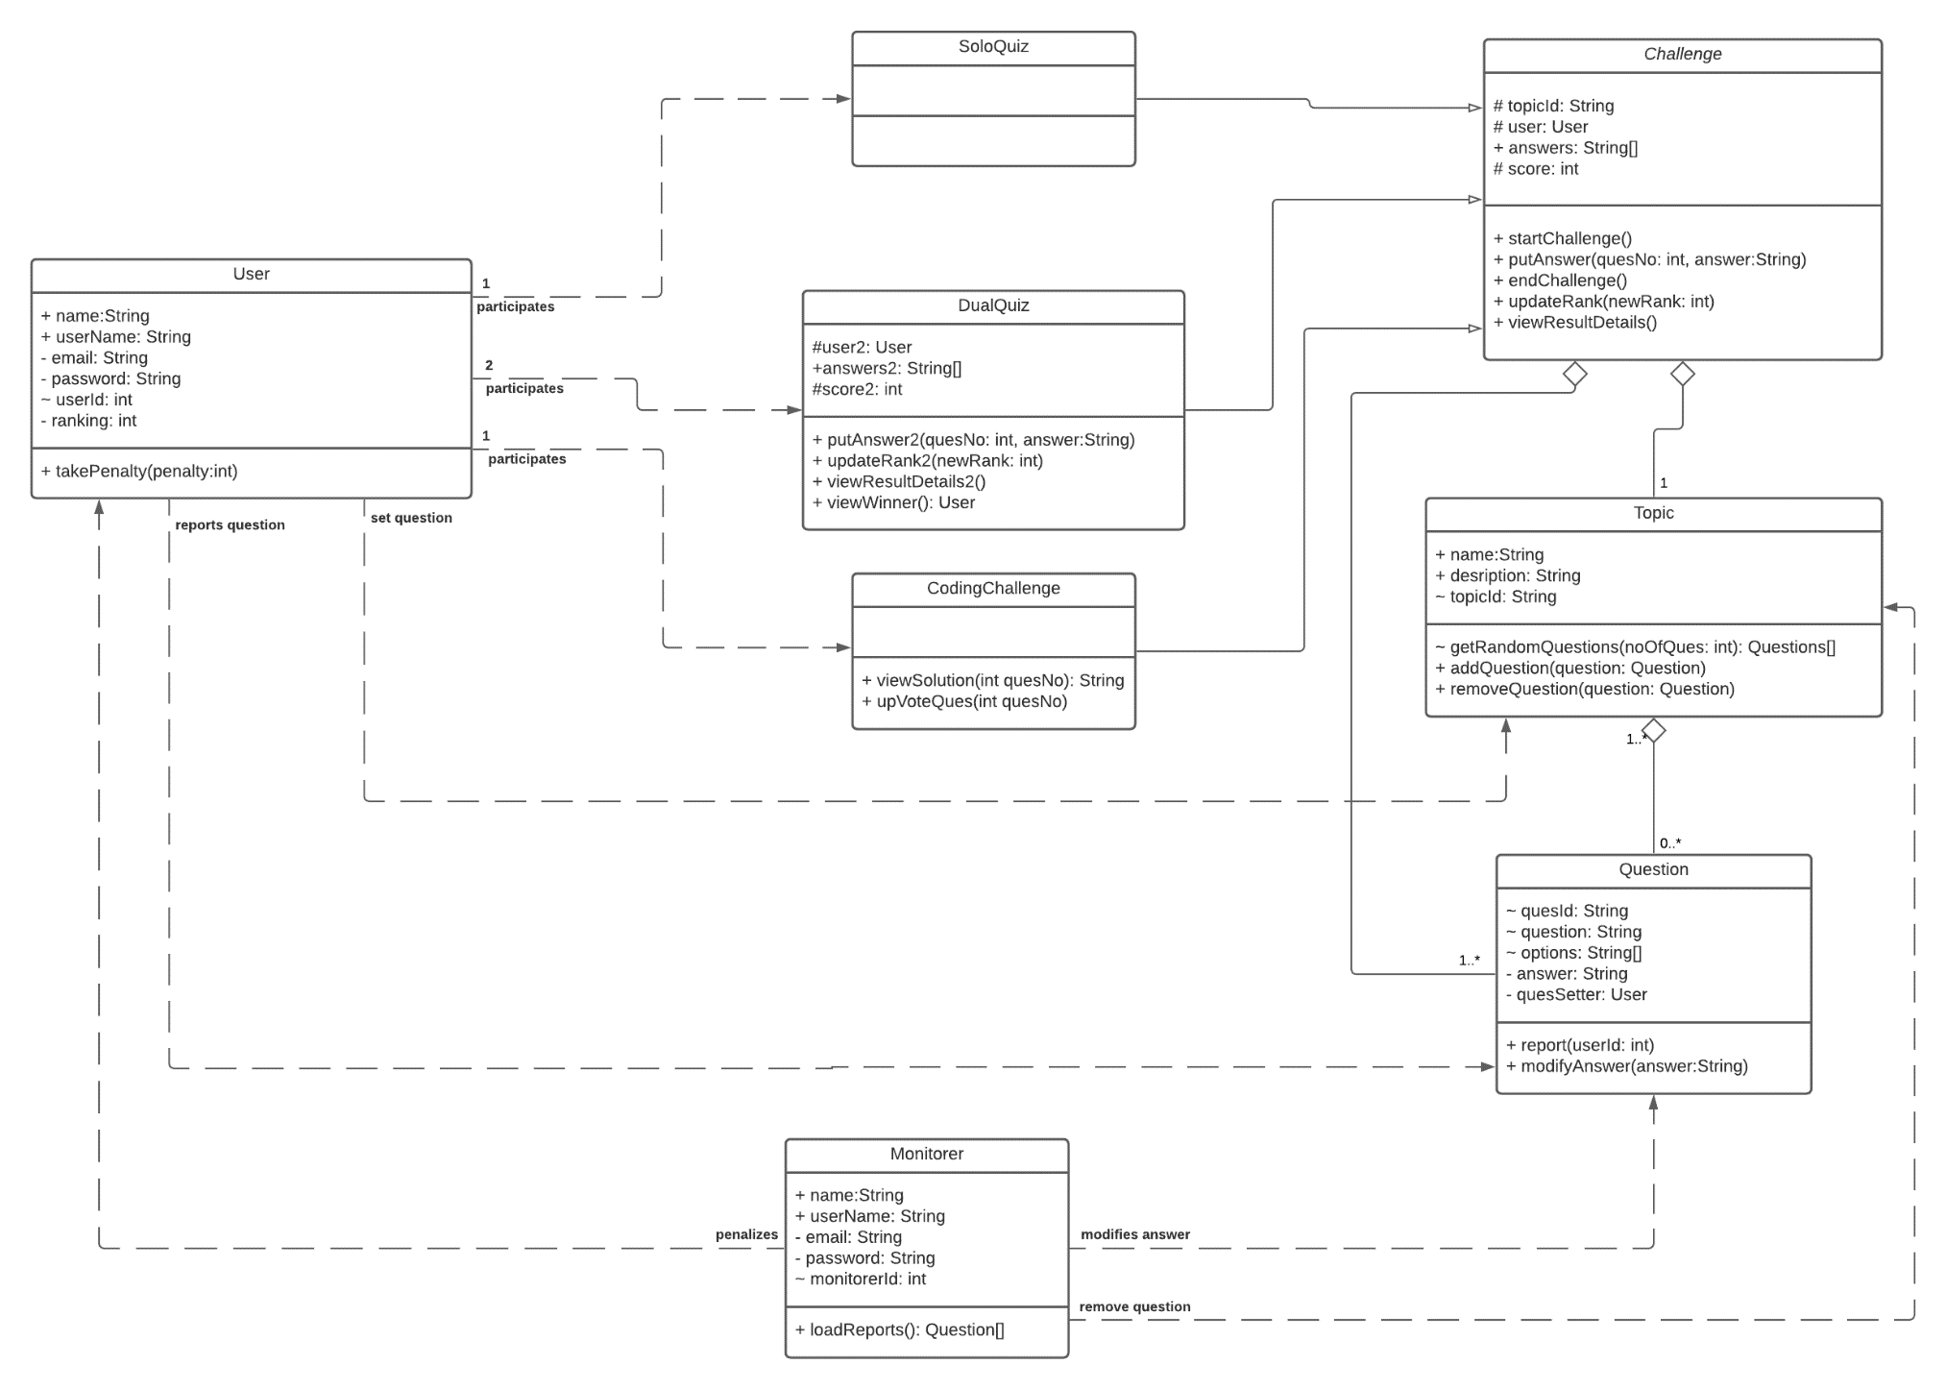

Slide 14
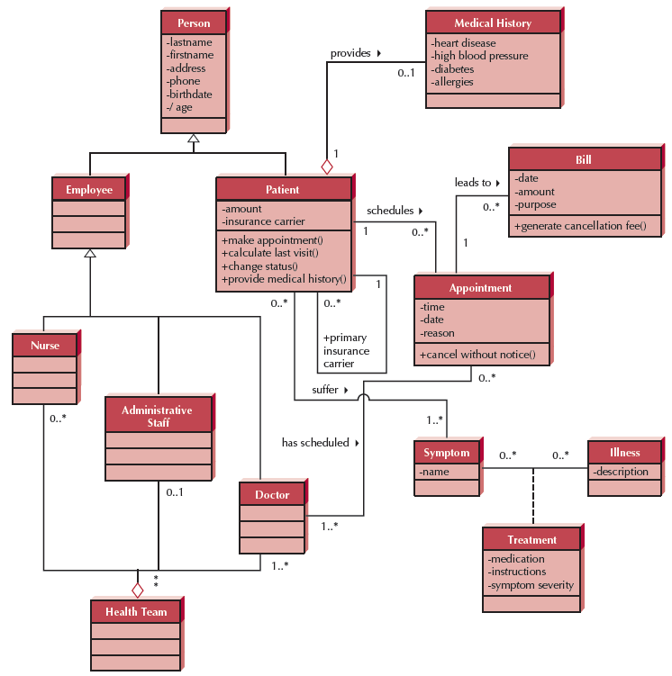
Class Diagram Example 3

